Slide 1

High Concept Documents
A “mini” lecture about a “mini” Game Design Document

Slide 2
What is a High Concept Document?
Details the major aspects of your game on 1-2 pages
Used to quickly give an interested party more information about your amazing interactive experience
Usually given to others after the “elevator pitch” is delivered
KEEP YOUR HIGH CONCEPT SHORT! IF YOU HAVE MORE THAN A PAGE OR TWO, CHANCES ARE YOUR GAME IS TOO COMPLEX FOR INVESTORS TO CONSIDER!!

Slide 3

1. High Concept Statement
A high concept statement is a slightly more refined elevator pitch. After the title/your name on the document, have no more than two lines/sentences describing the major gameplay experience of your game.
Must be concise to preserve time, the most valuable resource
Must be easily understandable to non-gamers, or executives in the gaming environment
“Jet Slinger is an endless runner style game, where the player must use their futuristic slingshot to shoot down invading mutant doughnuts from outer space. As the player earns rewards in each match, new slingshot upgrades and mutant doughnut enemies become available for them to purchase with in-game or real-world currency.”

Slide 4
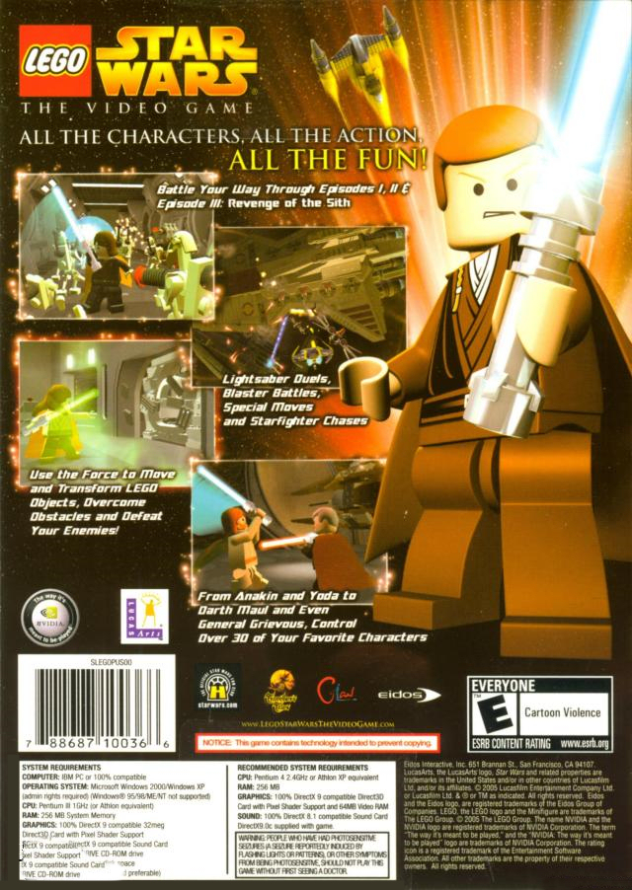
2. Features
Create a bullet-point list of the major features of your game (remember simple, easy to understand!)
Start with the unique features, something that will make your game stand out from its competition (usually only one or two)
Next, list the most “sellable” features; things that an investor can earn money with
Consider what you’d put on the back of a game box. Will these features draw/keep attention?

Slide 5
3. Overview
Player motivation
Genre
Licenses
Target Audience/Customers
Competition/Market Research
Unique Selling Points
Target Hardware/Specs Requirements
Design Goals/Future Plans
The major part of the document, this is an extensive overview of the various requirements/ targets for the game. By this stage you’ve got their attention, now it’s time to seal the deal. Make sure to cover all bases, while remaining concise at the same time!

Slide 6
4. Further Details
Any further information that an investor or prospective players will be interested in:
Characters
Artwork
Music
Narrative/Plot
DLC opportunities
Etc.
BE CAREFUL NOT TO ADD TOO MUCH! High Concept needs to be realized, but not finished. Some investors want to change things based on market interests, so the more you have finished means the more they can remove from the game.

